Slide 1
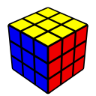
Improver Method – Pt. 4
Michael George
WCA ID: 2015GEOR02

Slide 2
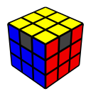
Permutation of the Last Layer (PLL)
“Beginner” method used 2 simple algorithms
16-move combination of Anti-Sune and Niklas for corner permutation (CPLL)
17-move combination of Anti-Sune and its left-handed mirror for edge permutation (EPLL)
“Improver” method will use 4 shorter but less intuitive algorithms
11-move and 14-move algorithms for corner permutation (Jb-Perm and Na-Perm) – R U L moves
11-move algorithms for edge permutation (Ua-Perm and Ub-Perm) – R U moves
The new algorithms will be slightly trickier to learn but well worth the effort!
The combination of Anti-Sune and Niklas will be shortened to 11 moves – optimised Jb-Perm
The Ua-Perm and Ub-Perm algorithms will be speed-optimised to 11 moves – R U only

Slide 3
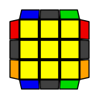
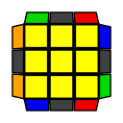
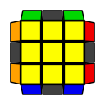
Corner Permutation of the Last Layer (CPLL)
There are 3 possible cases during CPLL including the “solved” case
The cases that need to be solved are the “diagonal corner swap” and the “adjacent corner swap”
The “adjacent” corner swap is the most common CPLL as it occurs in 4/6 solves
1/6
4/6
1/6

Slide 4
CPLL Algorithms
To change the permutation of corners you will use a mixture of R U L moves
The first CPLL algorithm (adjacent corner swap) is R U2 R’ U’ R U2 L’ U R’ U’ L
It may not be immediately obvious but it is actually the beginner algorithm after cancellations – see square brackets
It starts with the Anti-Sune algorithm that was used during OCLL – R U2 R’ U’ R [U’ R’]
It ends with the Niklas algorithm which manipulates two F2L pairs – [R U’] L’ U R’ U’ L [U]
The combination of these two algorithms is the Jb-Perm which swaps 2 diagonal LL corners + 2 LL edges
The second CPLL algorithm (diagonal corner swap) is (R U' L U2' R' U L') (R U' L U2' R' U L')
This is a 7-move algorithm which manipulates two F2L pairs, executed twice – R U' L U2' R' U L'
The repetition of this algorithm is the Na-Perm which swaps 2 adjacent LL corners + 2 LL edges

Slide 5
Adjacent Corner Swap
The “adjacent” corner swap can be recognised by the “headlights” on one side (shown in orange below)
Approach: “Adjacent corner swap” -> “solved”
Setup: Ensure the “Headlights” are on the left before executing the CPLL algorithm
Algorithm: R U2 R’ U’ R U2 L’ U R’ U’ L
Adjacent Swap
Solved

Slide 6
Diagonal Corner Swap
The “diagonal” corner swap can be recognised by the absence of “headlights”
Approach: “Diagonal corner swap” -> “solved”
Setup: No setup required… just execute the algorithm
Algorithm: (R U' L U2' R' U L') (R U' L U2' R' U L')
Diagonal Swap
Solved

Slide 7
CPLL Efficiency
“Beginner” – 1 algorithm – (R U2 R’ U2’) (U R U’ R’) (R U’ L’ U) (R’ U’ L U)
Adjacent Corner Swap 16 moves, 2 looks
Diagonal Corner Swap 33 moves, 4 looks
“Weighted Average” 16.2 moves, 2.2 looks
“Improver” – 2 algorithms – R U2 R’ U’ R U2 L’ U R’ U’ L and (R U’ L U2’ R’ U L') (R U’ L U2’ R’ U L')
Adjacent Corner Swap 11 moves, 1 look
Diagonal Corner Swap 14 moves, 1 look
“Weighted Average” 9.7 moves, 1 look
Diagonal
Adjacent
Solved

Slide 8
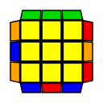
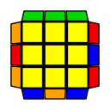
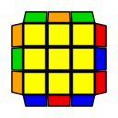
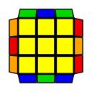
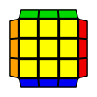
Edge Permutation of the Last Layer (EPLL)
There are 5 possible cases during EPLL including the “solved” case
4 misplaced edges require the most effort to solve when you only know a couple of algorithms
4/12
4/12
2/12
1/12
1/12

Slide 9
EPLL Algorithms
To change the permutation of edges we will only use R U moves
The first EPLL algorithm that will be used is R U’ R U R U R U’ R’ U’ R2
It is a conjugation of an algorithm that can be used during F2L – R U’ (R U R U R U’ R’ U’ R’ U’) U R’
The R U’ is referred to as a “setup” move and the U R’ will undo the setup
Applying cancellations results in the Ua-Perm which is a counter-clockwise “3-cycle” of LL edges
The second EPLL algorithm that will be used is R2 U R U R’ U’ R’ U’ R’ U R’
It is a conjugation of an algorithm that can be used during F2L – R U’ (U R U R U R’ U’ R’ U’ R’) U R’
The R U’ is referred to as a “setup” move and the U R’ will undo the setup
Applying cancellations results in the Ub-Perm which is a clockwise “3-cycle” of LL edges
Note how the two algorithms are both an “inverse” of each other

Slide 10
3 Misplaced Edges
There are 2 EPLL cases with 3 misplaced edges and they can be recognised by the “bar” (green below)
Approach: “Ua-Perm” or “Ub-Perm” -> “Solved”
Setup: Ensure the ”Bar” is at the back before executing the EPLL algorithm
Algorithm: R U’ R U R U R U’ R’ U’ R2 or R2 U R U R’ U’ R’ U’ R’ U R’ – depending on the case
Ua-Perm
Solved
Ub-Perm
Solved

Slide 11
4 Misplaced Edges
There are 2 EPLL cases with 4 misplaced edges and they take the most effort to solve
Approach: “Z-Perm” or “H-Perm” -> “Ub-Perm” -> “Solved”
Setup: Avoid the “Ua-Perm” by setting up the Z-Perm correctly before executing the EPLL algorithm
Algorithm: R U’ R U R U R U’ R’ U’ R2 – twice, remembering to AUF prior to execution
or
H-Perm
Z-Perm
Ua-Perm
Solved

Slide 12
EPLL Efficiency
“Beginner” – 1 algorithm – (R U2 R’ U2’) (U R U’ R’) U (L’ U2 L U2’) (U’ L’ U L)
3 Misplaced Edges – Ua or Ub 17 or 35 moves, 2 or 4 looks
4 Misplaced Edges – Z or H 34 or 35 moves, 4 looks
“Weighted Average” 25.9 moves, 3.1 looks
“Improver” – 2 algorithms – R U’ R U R U R U’ R’ U’ R2 and R2 U R U R’ U’ R’ U’ R’ U R
3 Misplaced Edges – Ua or Ub 11 moves, 1 look
4 Misplaced Edges – Z or H 23 moves, 2 looks
“Weighted Average” 13.1 moves, 1.3 looks
Ua-Perm
Ub-Perm
Z-Perm
H-Perm
Solved

Slide 13
PLL Efficiency
“Beginner” – 2 algorithms – beginner Jb-Perm + beginner Ub-Perm
“Worst Case” 68 moves, 8 looks
“Weighted Average” 42.1 moves, 5.3 looks
“Improver” – 4 algorithms – Jb-Perm + Na-Perm + Ua-Perm + Ub-Perm
“Worst Case” 37 moves, 3 looks
“Weighted Average” 22.8 moves, 2.3 looks
Comparison
“Worst Case” “Improver” method saves 31 moves, 5 looks –> 45.6% saving
“Weighted Average” “Improver” method saves 19.3 moves, 3 looks –> 45.9% saving

Slide 14
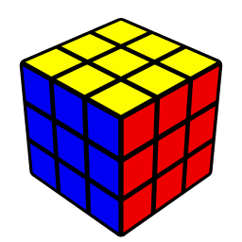

Congratulations!

